Slide 1


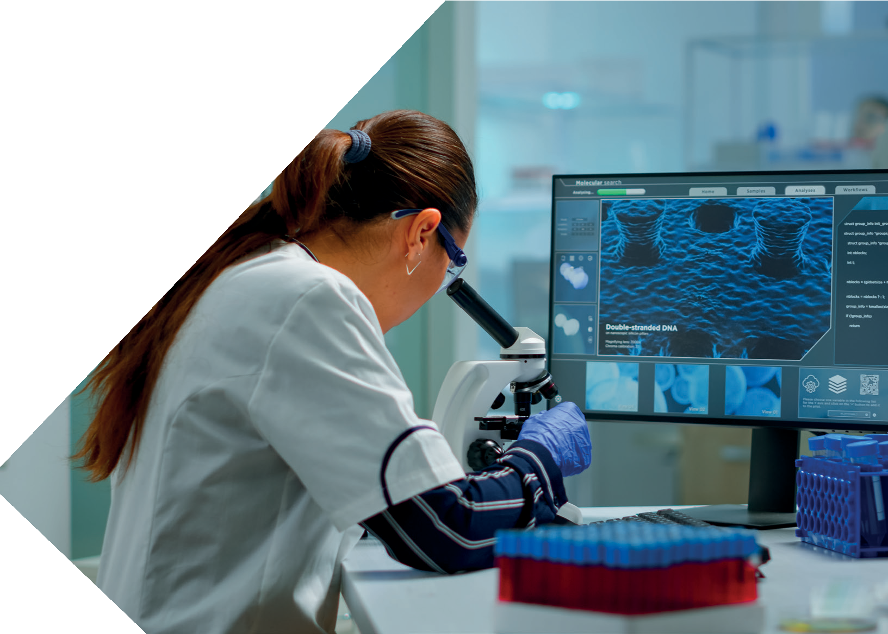







School of Pharmaceutical Sciences
Value added course
UGC Recognised
Under Section 2(f) & 12(B) of UGC
AI & Data Analytics in Drug Discovery and Healthcare
AY- 2026-27 SEM III
COURSE DURATION
30 HRS
Modules
Basics of Artificial Intelligence and Machine Learning
Introduction to Big Data in Pharmaceutical Sciences
Importance of Data Analytics in Clinical Decision Making
Course objective
Understand the basic concepts of Artificial Intelligence (AI), Machine Learning (ML), and Data Analytics in pharmaceutical sciences.
Explain the role of AI in drug discovery, development, and personalized medicine.
Introduce students to healthcare datasets and data visualization techniques.
Build basic skills in data handling, interpretation, and decision-making in pharmaceutical research.
Course outcome
students will be able to:
Explain the fundamentals of AI, machine learning, and data analytics in healthcare.
Analyze healthcare and pharmaceutical datasets using basic analytical tools.
Apply AI concepts in pharmacovigilance, diagnostics, and personalized medicine.
Agency
Six laddert
Campus: Mahiravani, Trimbak Road, Tal & Dist. Nashik–422213, Maharashtra, India.
1800-212-2714 info@sandipuniversity.edu.in
www.sandipuniversity.edu.in

